Slide 1

Vertical Position Reconstruction Update
SuperNEMO Collaboration Meeting 2024 Marseille
Sam Pratt

Slide 2
Outline
Overview of current vertical position reconstruction procedure in the tracker

Slide 3
Outline
Overview of current vertical position reconstruction procedure in the tracker
Highlight potential problems with the current method

Slide 4
Outline
Overview of current vertical position reconstruction procedure in the tracker
Highlight potential problems with the current method
Suggests corrections to the current reconstruction method

Slide 5
Outline
Overview of current vertical position reconstruction procedure in the tracker
Highlight potential problems with the current method
Suggests corrections to the current reconstruction method
Give overview of uncertainty on vertical position of passing electrons

Slide 6
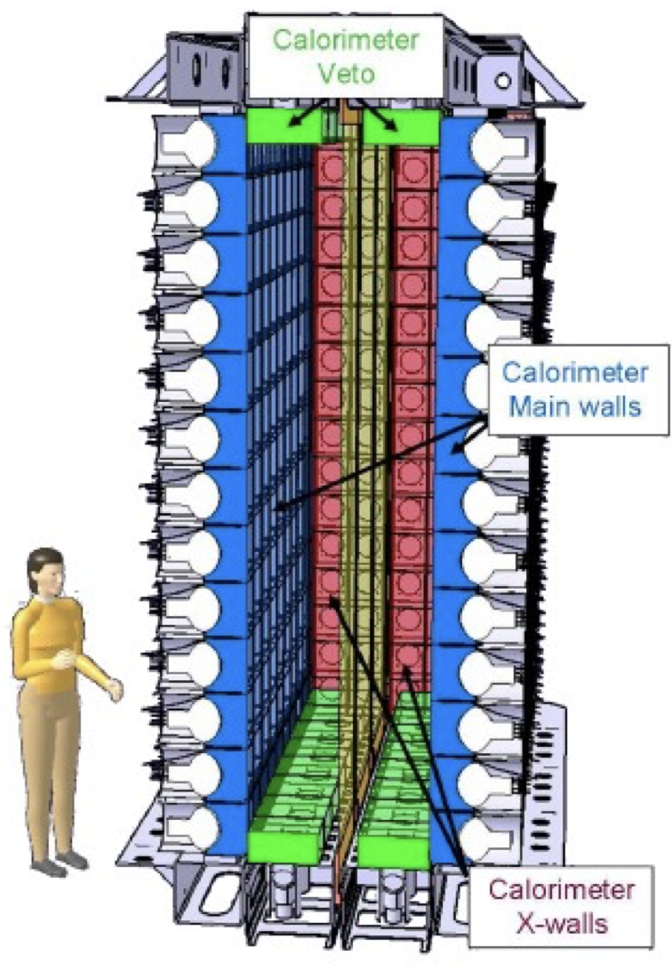
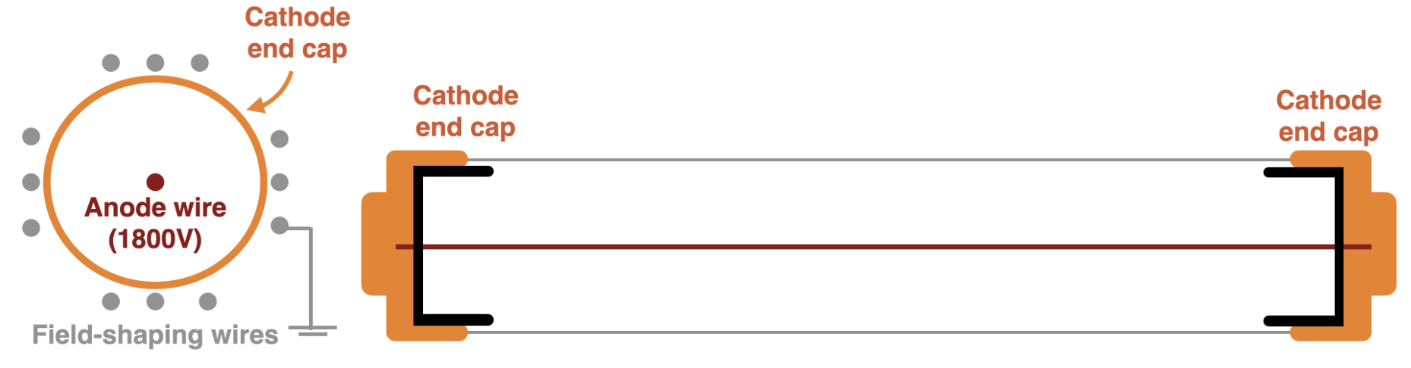
Overview of Tracker
Tracker Cell
Tracker Array
Full Detector
x113
x9
Aerial View
Side View
Tracker Array (side view)
Will summarise recorded information from the tracker

Slide 7
Overview of Current Reconstruction
Cell View
Cathode end cap
Anode wire
Cathode end cap

Slide 8
Overview of Tracker Cell
Cell View
Measured Signals
Anode signal*
Time
Cathode 1 signal*
Time
e-
Cathode 2 signal*
Time
*Differential of the voltage measured over the component

Slide 9
Overview of Tracker Cell
Cell View
Measured Signals
Recorded Information
Anode
Cathode 1
e-
Cathode 2
Time
Electron passes through cell

Slide 10
Overview of Tracker Cell
Cell View
Measured Signals
Recorded Information
Anode
T0 - Anode
Cathode 1
e-
Cathode 2
t0
Time
Avalanche triggered in cell

Slide 11
Overview of Tracker Cell
Cell View
Measured Signals
Recorded Information
Anode
T0 - Anode
T1,T2 - Anode
Ttop Cathode
Cathode 1
e-
Cathode 2
t0
t1
t3
ttop
Time
Plasma reaches near cathode

Slide 12
Overview of Tracker Cell
Cell View
Measured Signals
Recorded Information
Anode
T0 - Anode
T1,T2 - Anode
Ttop Cathode
T3,T4 –Anode
Tbot – Cathode
Cathode 1
e-
Cathode 2
t0
t1
t3
ttop
t2
t4
tbot
Time
Plasma reaches far cathode
Time

Slide 13
Overview of Tracker Cell
Cell View
Measured Signals
Recorded Information
Anode
T0 - Anode
T1,T2 - Anode
Ttop Cathode
T3,T4 –Anode
Tbot – Cathode
Cathode 1
e-
Cathode 2
Time
Time

Slide 14
Reconstruction Procedure
e-
Time

Slide 15
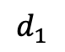
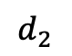
Reconstruction Procedure
H
h
$$d_{1}$$
$$d_{2}$$

Slide 16
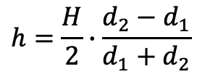
Reconstruction Procedure
Height Calculation
$$h=\frac{H}{2}∙\frac{d_{2}−d_{1}}{d_{1}+d_{2}}$$
H
h
$$d_{1}$$
$$d_{2}$$

Slide 17


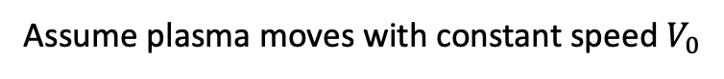
Reconstruction Procedure
Height Calculation
$$h=\frac{H}{2}∙\frac{d_{2}−d_{1}}{d_{1}+d_{2}}$$
H
Assume plasma moves with constant speed $V_{0}$
h
$$d_{2}=V_{0}(t_{top}−t_{0})$$
$$d_{1}=V_{0}(t_{bot}−t_{0})$$
$$d_{1}$$
$$d_{2}$$

Slide 18
Reconstruction Procedure
Anode
Height Calculation
$$h=\frac{H}{2}∙\frac{d_{2}−d_{1}}{d_{1}+d_{2}}$$
H
t0
Cathode 1
Assume plasma moves with constant speed $V_{0}$
h
$$d_{2}=V_{0}(t_{top}−t_{0})$$
$$d_{1}=V_{0}(t_{bot}−t_{0})$$
$$d_{1}$$
$$d_{2}$$
tbot
Cathode 2
ttop
Time

Slide 19
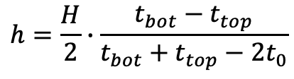
Reconstruction Procedure
Anode
Height Calculation
$$h=\frac{H}{2}∙\frac{d_{2}−d_{1}}{d_{1}+d_{2}}$$
H
t0
Cathode 1
Assume plasma moves with constant speed $V_{0}$
h
$$d_{2}=V_{0}(t_{top}−t_{0})$$
$$d_{1}=V_{0}(t_{bot}−t_{0})$$
$$d_{1}$$
$$d_{2}$$
tbot
Cathode 2
Current height formula
$$h=\frac{H}{2}∙\frac{t_{bot}−t_{top}}{t_{bot}+t_{top}−2t_{0}}$$
ttop
Time

Slide 20
Assumptions made in reconstruction
Constant plasma speed:

Slide 21
Assumptions made in reconstruction
Constant plasma speed:
Timestamps do not need to be corrected before being used in reconstruction
Voltage
Time

Slide 22
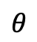
Assumptions made in reconstruction
Constant plasma speed:
Timestamps do not need to be corrected before being used in reconstruction
Voltage
Time
Angle of track doesn’t affect our ability to reconstruct
$$θ$$

Slide 23
Assumptions made in reconstruction
Constant plasma speed:
Timestamps do not need to be corrected before being used in reconstruction
Voltage
Time
Angle of track doesn’t affect our ability to reconstruct
$$θ$$
(+ others …)
All these assumptions break down at some scale. Goal is to find scale at which they break and estimate uncertainties as a result.
Methods for correcting these effects have also been suggested.

Slide 24
Assumptions made in reconstruction
Constant plasma speed:
Timestamps do not need to be corrected before being used in reconstruction
Voltage
Time
Angle of track doesn’t affect our ability to reconstruct
$$θ$$
(+ others …)
All these assumptions break down at some scale. Goal is to find scale at which they break and estimate uncertainties as a result.
Methods for correcting these effects have also been suggested.

Slide 25
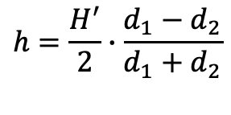
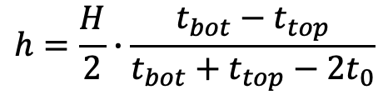
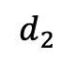
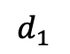
Assumption 1 – Constant Plasma Speed
Previously assumed plasma moves with constant speed
H
h
$$h=\frac{H^{′}}{2}∙\frac{d_{1}−d_{2}}{d_{1}+d_{2}}$$
$$h=\frac{H}{2}∙\frac{t_{bot}−t_{top}}{t_{bot}+t_{top}−2t_{0}}$$
$$d_{1}$$
$$d_{2}$$

Slide 26
Assumption 1 – Constant Plasma Speed
Previously assumed plasma moves with constant speed
Expect plasma to decelerate due to voltage drop over anode
H
h
$$h=\frac{H^{′}}{2}∙\frac{d_{1}−d_{2}}{d_{1}+d_{2}}$$
$$h=\frac{H}{2}∙\frac{t_{bot}−t_{top}}{t_{bot}+t_{top}−2t_{0}}$$
$$d_{1}$$
$$d_{2}$$

Slide 27
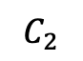
Assumption 1 – Constant Plasma Speed
Previously assumed plasma moves with constant speed
Expect plasma to decelerate due to voltage drop over anode
Voltage change is related to discharge of a capacitor connected to anode
H
h
$$h=\frac{H^{′}}{2}∙\frac{d_{1}−d_{2}}{d_{1}+d_{2}}$$
$$h=\frac{H}{2}∙\frac{t_{bot}−t_{top}}{t_{bot}+t_{top}−2t_{0}}$$
$$d_{1}$$
$$d_{2}$$
Anode wire
…
$$C_{2}$$
…

Slide 28
Assumption 1 – Constant Plasma Speed
Previously assumed plasma moves with constant speed
Expect plasma to decelerate due to voltage drop over anode
Voltage change is related to discharge of a capacitor connected to anode
NEMO-3 accounted for this effect using a correction term
H
h
$$h=\frac{H^{′}}{2}∙\frac{d_{1}−d_{2}}{d_{1}+d_{2}}$$
$$h=\frac{H}{2}∙\frac{t_{bot}−t_{top}}{t_{bot}+t_{top}−2t_{0}}$$
$$d_{1}$$
$$d_{2}$$
Anode wire
…
$$C_{2}$$
…

Slide 29
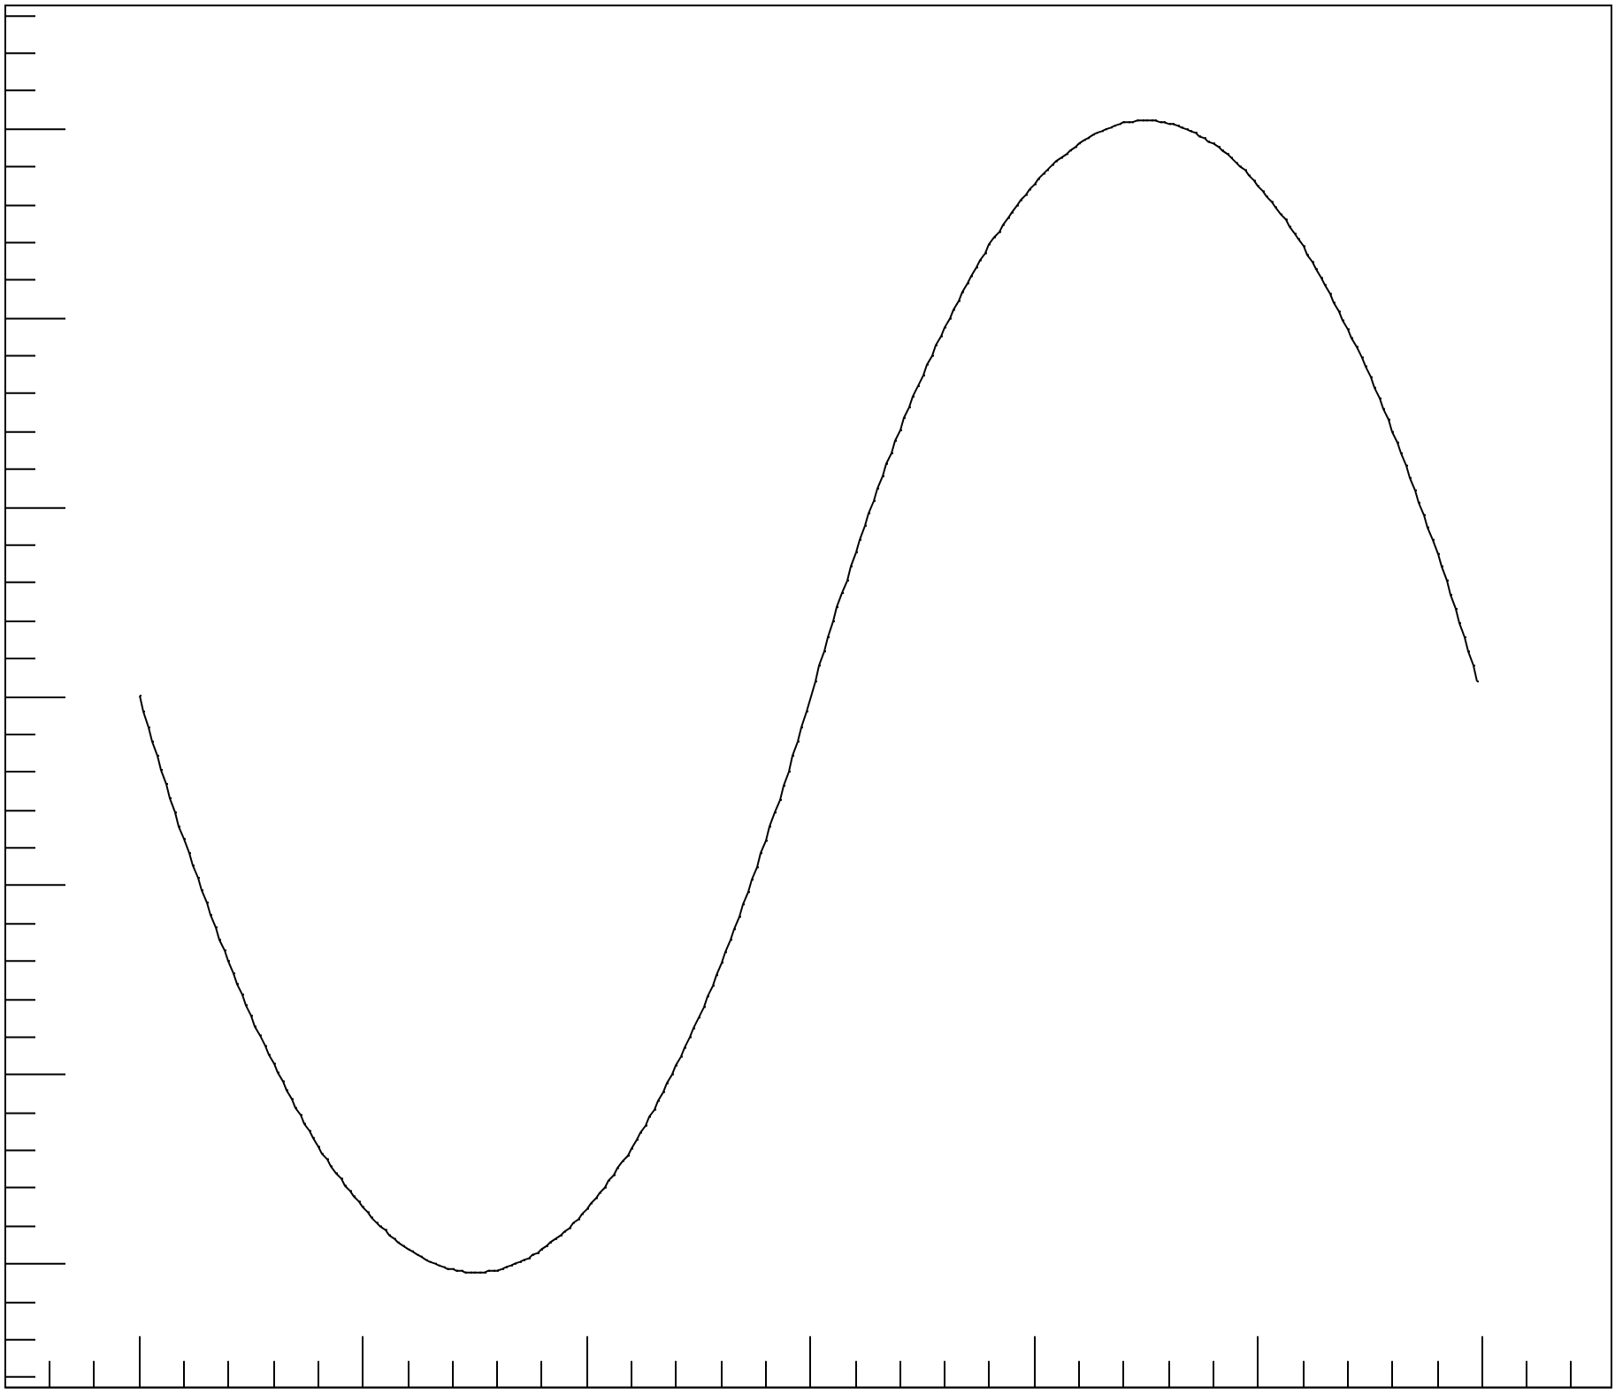
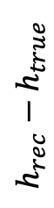
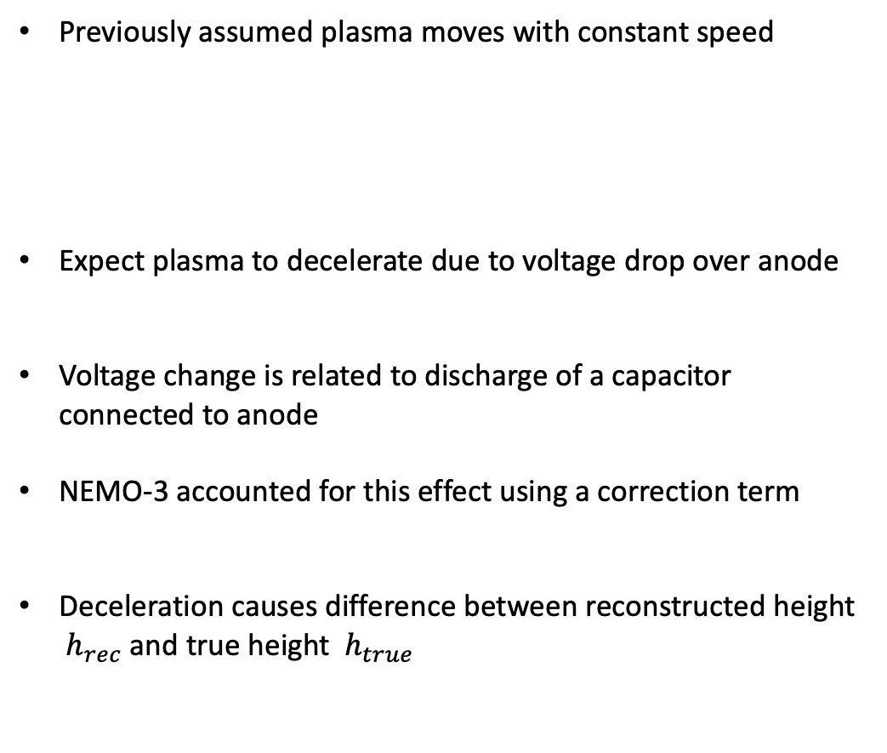
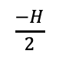
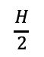
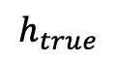
Assumption 1 – Constant Plasma Speed
Previously assumed plasma moves with constant speed
Expect plasma to decelerate due to voltage drop over anode
Voltage change is related to discharge of a capacitor connected to anode
NEMO-3 accounted for this effect using a correction term
Deceleration causes difference between reconstructed height ${ h}_{rec}$ and true height${ h}_{true}$
H
h
$$h=\frac{H^{′}}{2}∙\frac{d_{1}−d_{2}}{d_{1}+d_{2}}$$
$$h=\frac{H}{2}∙\frac{t_{bot}−t_{top}}{t_{bot}+t_{top}−2t_{0}}$$
$$d_{1}$$
$$d_{2}$$
$$h_{rec}−h_{true}$$
$$\frac{−H}{2}$$
$$h_{true}$$
$$\frac{H}{2}$$

Slide 30
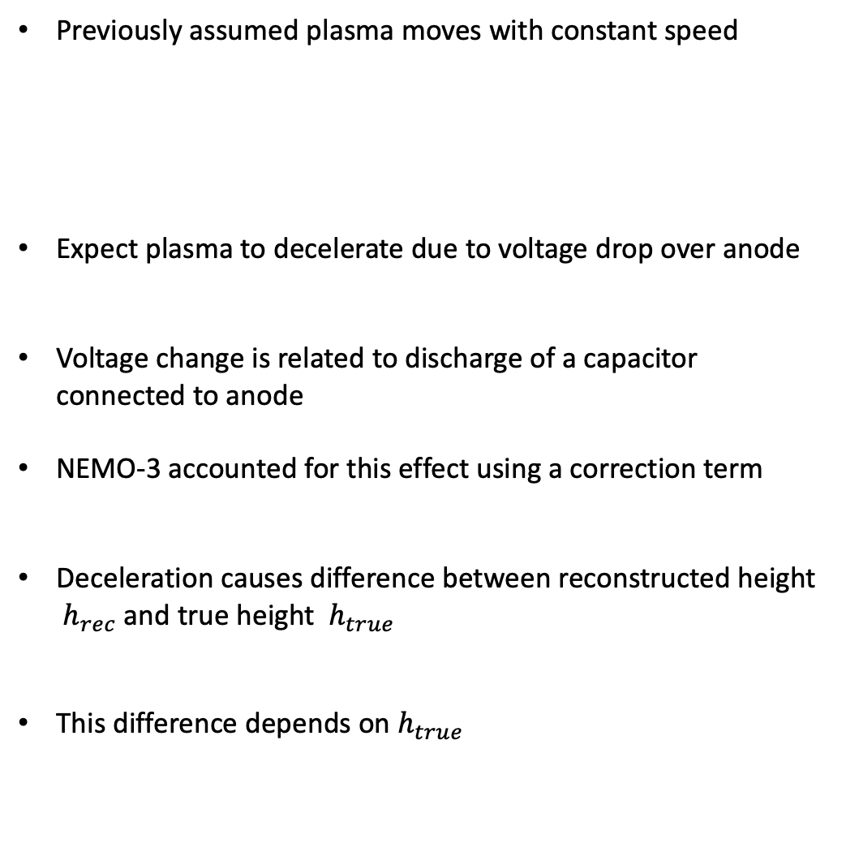
Assumption 1 – Constant Plasma Speed
Previously assumed plasma moves with constant speed
Expect plasma to decelerate due to voltage drop over anode
Voltage change is related to discharge of a capacitor connected to anode
NEMO-3 accounted for this effect using a correction term
Deceleration causes difference between reconstructed height ${ h}_{rec}$ and true height${ h}_{true}$
This difference depends on${ h}_{true}$
H
h
$$h=\frac{H^{′}}{2}∙\frac{d_{1}−d_{2}}{d_{1}+d_{2}}$$
$$h=\frac{H}{2}∙\frac{t_{bot}−t_{top}}{t_{bot}+t_{top}−2t_{0}}$$
$$d_{1}$$
$$d_{2}$$
$$h_{rec}−h_{true}$$
$$\frac{−H}{2}$$
$$h_{true}$$
$$\frac{H}{2}$$

Slide 31
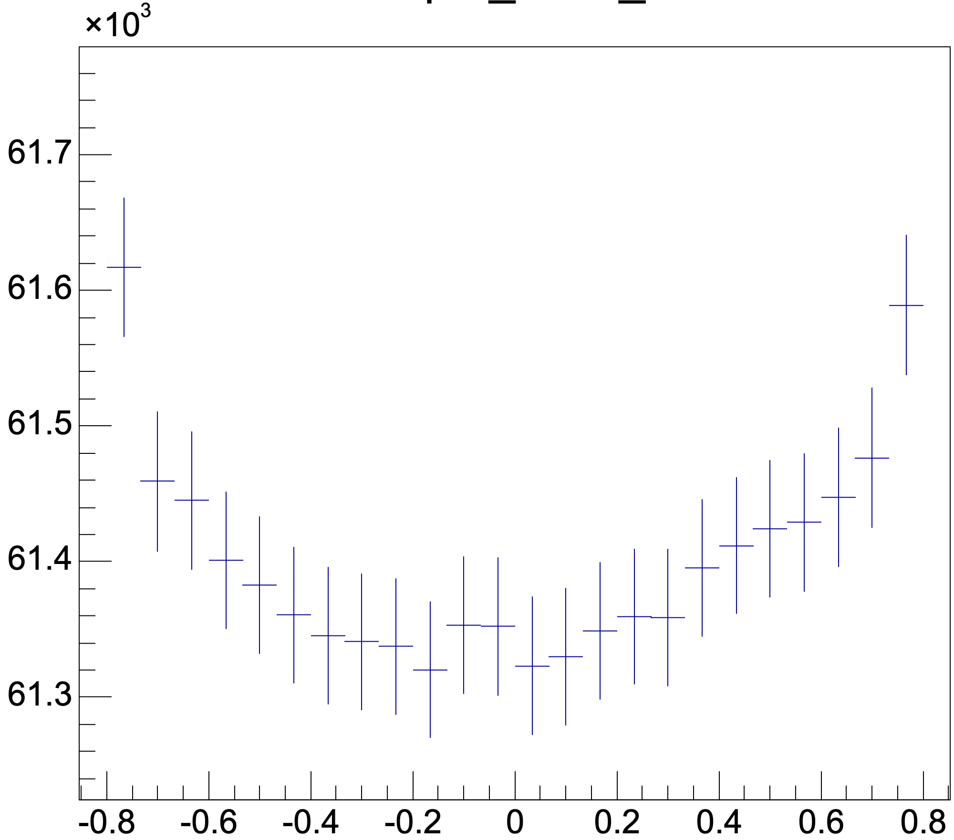
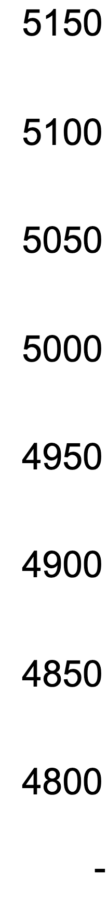
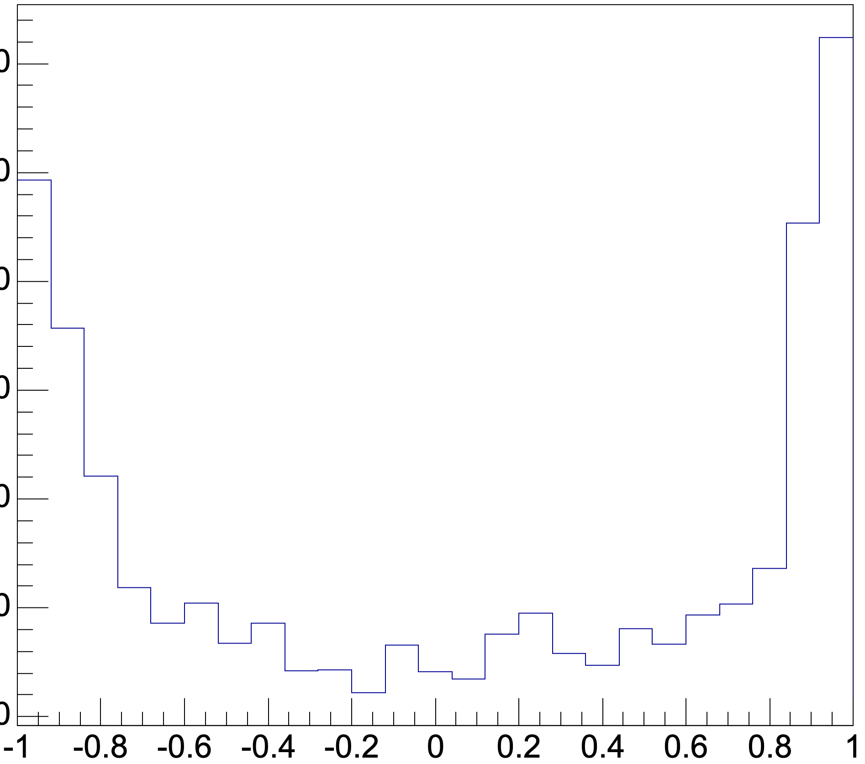
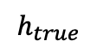
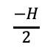
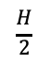
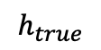
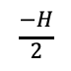
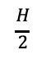
Evidence of Deceleration
Propagation time depends on $h_{rec}$ - 2% effect in prop time at max
Individual Cell
Propagation time (ns)
Propagation time (10ns)
$$\frac{−H}{2}$$
$$h_{true}$$
$$\frac{H}{2}$$
$$\frac{−H}{2}$$
$$h_{true}$$
$$\frac{H}{2}$$

Slide 32
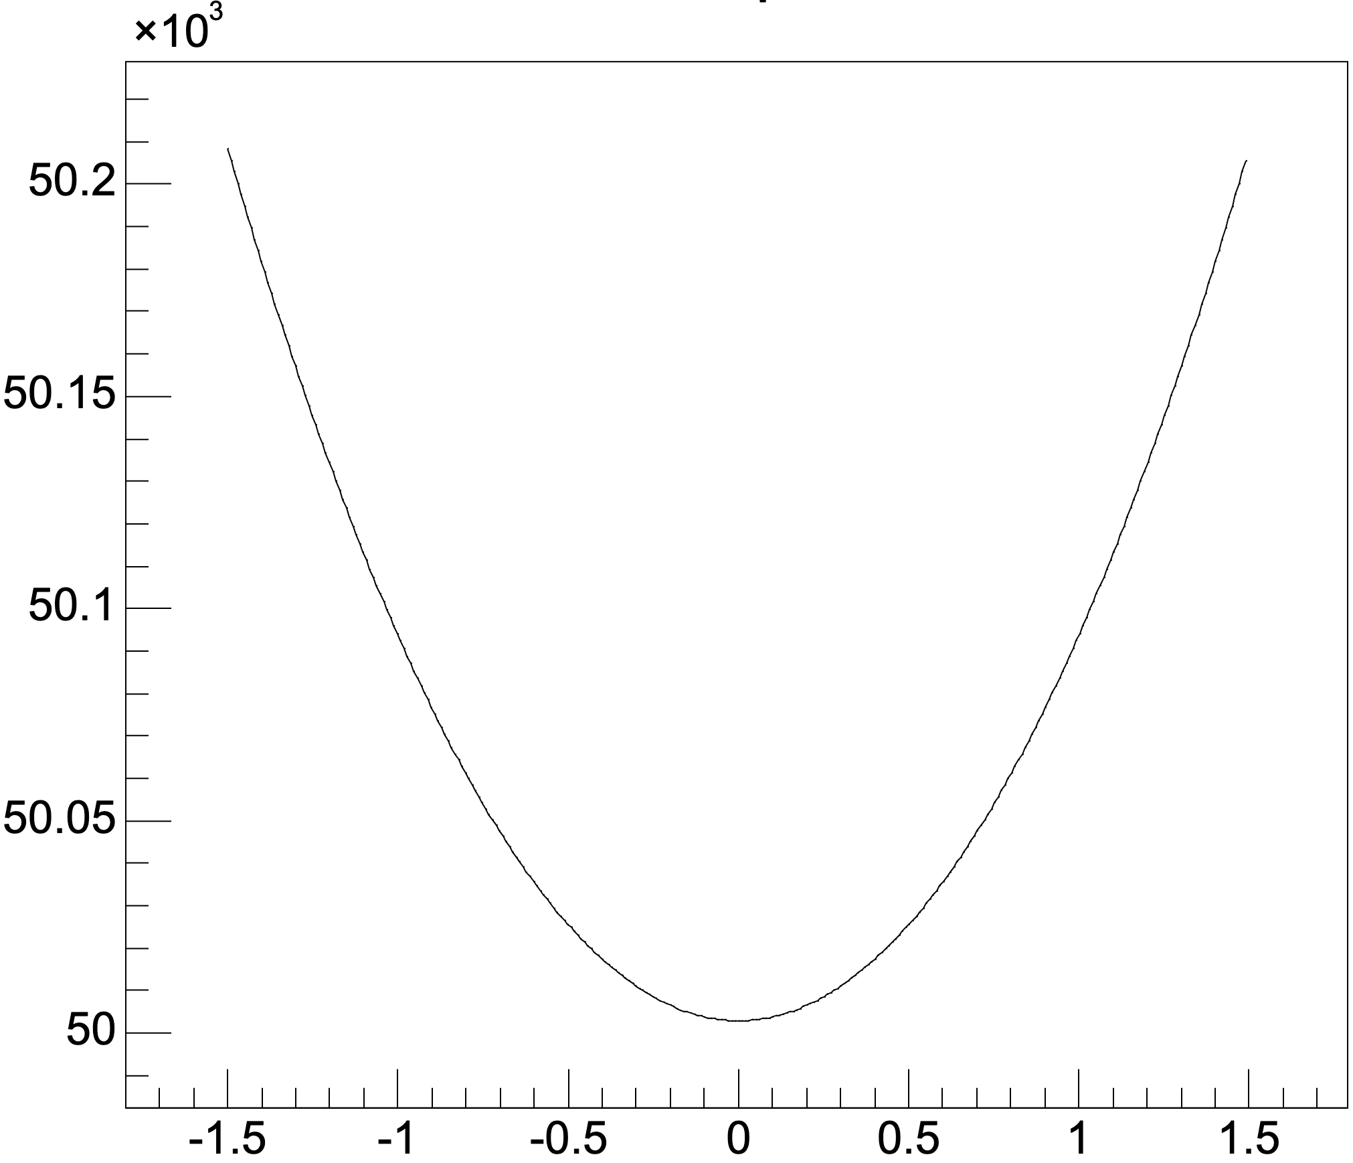
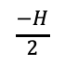
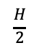
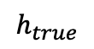
Evidence of Deceleration
Propagation time depends on $h_{rec}$ - 2% effect in prop time at max
Individual Cell
Expected
Propagation time (ns)
Propagation time (10ns)
Propagation time (ns)
$$\frac{−H}{2}$$
$$h_{true}$$
$$\frac{H}{2}$$
$$\frac{−H}{2}$$
$$h_{true}$$
$$\frac{H}{2}$$
$$\frac{−H}{2}$$
$$h_{true}$$
$$\frac{H}{2}$$

Slide 33
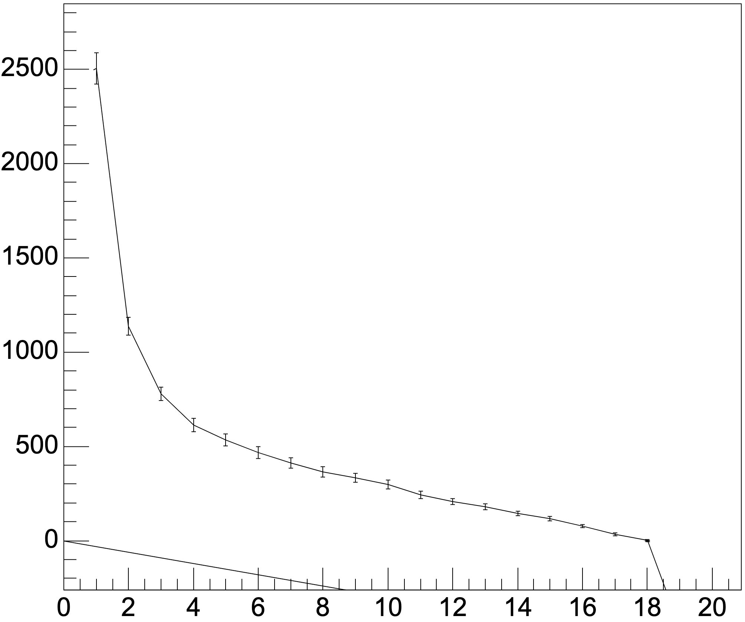
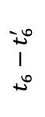
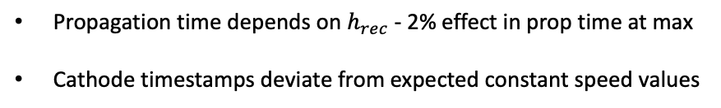
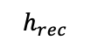
Evidence of Deceleration
Propagation time depends on $h_{rec}$ - 2% effect in prop time at max
Cathode timestamps deviate from expected constant speed values
Individual Cell
Propagation time (ns)
Propagation time (10ns)
$$t_{6}−t_{6}^{′}$$
$$\frac{−H}{2}$$
$$h_{true}$$
$$\frac{H}{2}$$
$$\frac{H}{2}$$
$$h_{rec}$$
$$\frac{−H}{2}$$
$$h_{true}$$
** NEMO-3 used model of changing deceleration – this could be left over effect or something else

Slide 34
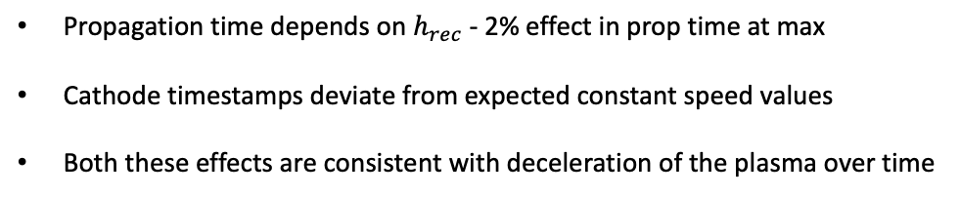
Evidence of Deceleration
Propagation time depends on $h_{rec}$ - 2% effect in prop time at max
Cathode timestamps deviate from expected constant speed values
Both these effects are consistent with deceleration of the plasma over time
Individual Cell
Propagation time (ns)
Propagation time (10ns)
$$t_{6}−t_{6}^{′}$$
$$\frac{−H}{2}$$
$$h_{true}$$
$$\frac{H}{2}$$
$$\frac{H}{2}$$
$$h_{rec}$$
$$\frac{−H}{2}$$
$$h_{true}$$
** NEMO-3 used model of changing deceleration – this could be left over effect or something else

Slide 35
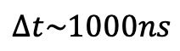
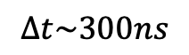
Scale of effect
Change in propagation time from centre to edge of cell
$$Δt\sim 300ns$$
Deviation in cathode timestamp over height
$$Δt\sim 1000ns$$

Slide 36
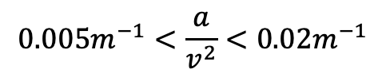
Scale of effect
Change in propagation time from centre to edge of cell
$$Δt\sim 300ns$$
Deviation in cathode timestamp over height
$$Δt\sim 1000ns$$
Suggests deceleration scale:
$$0.005m^{−1}<\frac{a}{v^{2}}<0.02m^{−1}$$

Slide 37
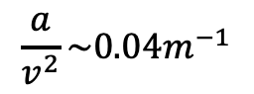
Scale of effect
Change in propagation time from centre to edge of cell
$$Δt\sim 300ns$$
Deviation in cathode timestamp over height
$$Δt\sim 1000ns$$
Suggests deceleration scale:
$$0.005m^{−1}<\frac{a}{v^{2}}<0.02m^{−1}$$
NEMO-3
$$\frac{a}{v^{2}}\sim 0.04m^{−1}$$

Slide 38
Scale of effect
Change in propagation time from centre to edge of cell
$$Δt\sim 300ns$$
Deviation in cathode timestamp over height
$$Δt\sim 1000ns$$
Suggests deceleration scale:
$$0.005m^{−1}<\frac{a}{v^{2}}<0.02m^{−1}$$
NEMO-3
$$\frac{a}{v^{2}}\sim 0.04m^{−1}$$
Suggests prop time estimate is an underestimate – we get cancellation effects due to non-constant deceleration

Slide 39
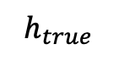
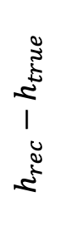
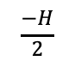
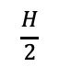
Scale of effect
Change in propagation time from centre to edge of cell
$$Δt\sim 300ns$$
Deviation in cathode timestamp over height
$$Δt\sim 1000ns$$
Suggests deceleration scale:
$$0.005m^{−1}<\frac{a}{v^{2}}<0.02m^{−1}$$
NEMO-3
$$\frac{a}{v^{2}}\sim 0.04m^{−1}$$
$$h_{rec}−h_{true}$$
Suggests prop time estimate is an underestimate – we get cancellation effects due to non-constant deceleration
Effect could range from 1mm to >1cm
$$\frac{−H}{2}$$
$$h_{true}$$
$$\frac{H}{2}$$
NEMO-3 corrected difference was 8mm

Slide 40
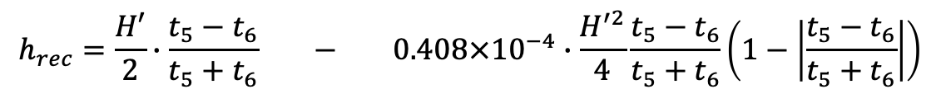
Correction
NEMO-3 correction
$$h_{rec}=\frac{H′}{2}∙\frac{t_{5}−t_{6}}{t_{5}+t_{6}} − 0.408×{10}^{−4}∙\frac{H^{′2}}{4}\frac{t_{5}−t_{6}}{t_{5}+t_{6}}\left(1−\left|\frac{t_{5}−t_{6}}{t_{5}+t_{6}}\right|\right)$$

Slide 41
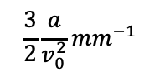
Correction
NEMO-3 correction
$$h_{rec}=\frac{H′}{2}∙\frac{t_{5}−t_{6}}{t_{5}+t_{6}} − 0.408×{10}^{−4}∙\frac{H^{′2}}{4}\frac{t_{5}−t_{6}}{t_{5}+t_{6}}\left(1−\left|\frac{t_{5}−t_{6}}{t_{5}+t_{6}}\right|\right)$$
Current formula
$$\frac{3}{2}\frac{a}{v_{0}^{2}}{mm}^{−1}$$
Deceleration term

Slide 42
Correction
NEMO-3 correction
$$h_{rec}=\frac{H′}{2}∙\frac{t_{5}−t_{6}}{t_{5}+t_{6}} − 0.408×{10}^{−4}∙\frac{H^{′2}}{4}\frac{t_{5}−t_{6}}{t_{5}+t_{6}}\left(1−\left|\frac{t_{5}−t_{6}}{t_{5}+t_{6}}\right|\right)$$
Current formula
$$\frac{3}{2}\frac{a}{v_{0}^{2}}{mm}^{−1}$$
Deceleration term
Basis of nemo-3 correction:
Assumes deceleration halves during propagation
Difference in ts values between current reconstruction and using NEMO-3 reconstruction

Slide 43
Correction
NEMO-3 correction
$$h_{rec}=\frac{H′}{2}∙\frac{t_{5}−t_{6}}{t_{5}+t_{6}} − 0.408×{10}^{−4}∙\frac{H^{′2}}{4}\frac{t_{5}−t_{6}}{t_{5}+t_{6}}\left(1−\left|\frac{t_{5}−t_{6}}{t_{5}+t_{6}}\right|\right)$$
Current formula
$$\frac{3}{2}\frac{a}{v_{0}^{2}}{mm}^{−1}$$
Deceleration term
Basis of nemo-3 correction:
Assumes deceleration halves during propagation
Benefits of nemo-3 correction:
Unitless correction values
Can be customized for each cell/depending on location of cell
Difference in ts values between current reconstruction and using NEMO-3 reconstruction

Slide 44
Correction
NEMO-3 correction
$$h_{rec}=\frac{H′}{2}∙\frac{t_{5}−t_{6}}{t_{5}+t_{6}} − 0.408×{10}^{−4}∙\frac{H^{′2}}{4}\frac{t_{5}−t_{6}}{t_{5}+t_{6}}\left(1−\left|\frac{t_{5}−t_{6}}{t_{5}+t_{6}}\right|\right)$$
Current formula
$$\frac{3}{2}\frac{a}{v_{0}^{2}}{mm}^{−1}$$
Deceleration term
Basis of nemo-3 correction:
Assumes deceleration halves during propagation
Benefits of nemo-3 correction:
Unitless correction values
Can be customized for each cell/depending on location of cell
Next steps:
Need to verify we see the same effect as they did

Slide 45
Correction
NEMO-3 correction
$$h_{rec}=\frac{H′}{2}∙\frac{t_{5}−t_{6}}{t_{5}+t_{6}} − 0.408×{10}^{−4}∙\frac{H^{′2}}{4}\frac{t_{5}−t_{6}}{t_{5}+t_{6}}\left(1−\left|\frac{t_{5}−t_{6}}{t_{5}+t_{6}}\right|\right)$$
Current formula
$$\frac{3}{2}\frac{a}{v_{0}^{2}}{mm}^{−1}$$
Deceleration term
Basis of nemo-3 correction:
Assumes deceleration halves during propagation
Benefits of nemo-3 correction:
Unitless correction values
Can be customized for each cell/depending on location of cell
Next steps:
Need to verify we see the same effect as they did
Need to verify way of calculating deceleration value is valid

Slide 46
Correction
NEMO-3 correction
$$h_{rec}=\frac{H′}{2}∙\frac{t_{5}−t_{6}}{t_{5}+t_{6}} − 0.408×{10}^{−4}∙\frac{H^{′2}}{4}\frac{t_{5}−t_{6}}{t_{5}+t_{6}}\left(1−\left|\frac{t_{5}−t_{6}}{t_{5}+t_{6}}\right|\right)$$
Current formula
$$\frac{3}{2}\frac{a}{v_{0}^{2}}{mm}^{−1}$$
Deceleration term
Basis of nemo-3 correction:
Assumes deceleration halves during propagation
Benefits of nemo-3 correction:
Unitless correction values
Can be customized for each cell/depending on location of cell
Next steps:
Need to verify we see the same effect as they did
Need to verify way of calculating deceleration value is valid
Test how this reconstruction affects tracking/location abilities

Slide 47
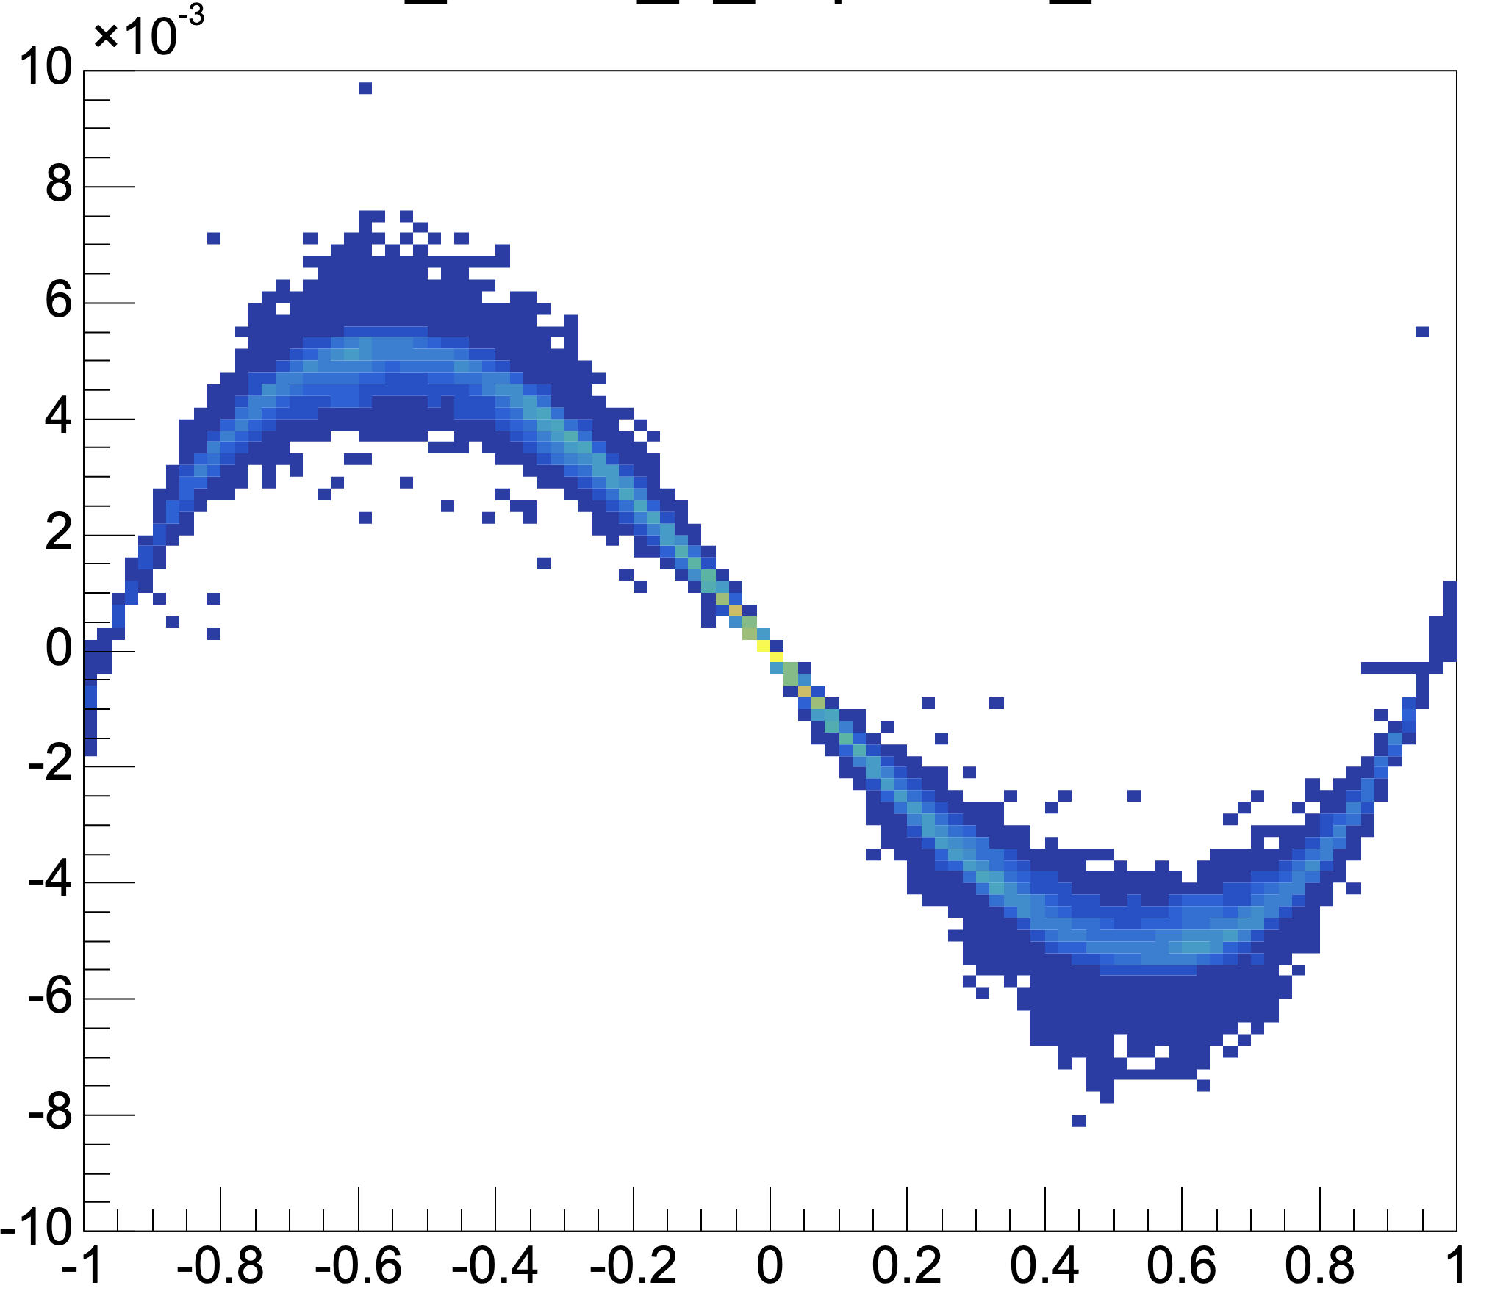
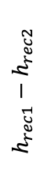

Correction
NEMO-3 correction
$$h_{rec}=\frac{H′}{2}∙\frac{t_{5}−t_{6}}{t_{5}+t_{6}} − 0.408×{10}^{−4}∙\frac{H^{′2}}{4}\frac{t_{5}−t_{6}}{t_{5}+t_{6}}\left(1−\left|\frac{t_{5}−t_{6}}{t_{5}+t_{6}}\right|\right)$$
Current formula
$$\frac{3}{2}\frac{a}{v_{0}^{2}}{mm}^{−1}$$
Deceleration term
Basis of nemo-3 correction:
Assumes deceleration halves during propagation
Benefits of nemo-3 correction:
Unitless correction values
Can be customized for each cell/depending on location of cell
Next steps:
Need to verify we see the same effect as they did
Need to verify way of calculating deceleration value is valid
Test how this reconstruction affects tracking/location abilities
$$h_{rec1}−h_{rec2}$$
If effect<5mm do we need to correct?
$$h_{rec1}$$
Difference in ts values between current reconstruction and using NEMO-3 reconstruction

Slide 48
Assumptions made in reconstruction
Constant plasma speed:
Timestamps do not need to be corrected before being used in reconstruction
Voltage
Time
Angle of track doesn’t affect our ability to reconstruct
$$θ$$
(+ others …)
All these assumptions break down at some scale. Goal is to find scale at which they break and estimate uncertainties as a result.
Methods for correcting these effects have also been suggested.

Slide 49
Assumption 2 – Timestamps don’t need correcting
Anode waveform
If prop time changes more when using
Anode time measurements would be
Perfect metric for that !
Does t5 to t6 change with height ?

Slide 50





Assumption 2 – Timestamps don’t need correcting
Anode waveform
Upper threshold
Lower threshold
If prop time changes more when using
Anode time measurements would be
Perfect metric for that !
Does t5 to t6 change with height ?
$$t_{0}$$
$$t_{1}$$
$$t_{3}$$
$$t_{2}$$
$$t_{4}$$

Slide 51
Assumption 2 – Timestamps don’t need correcting
Anode waveform
Upper threshold
Range 1
Range 2
Range 3
Lower threshold
If prop time changes more when using
Anode time measurements would be
Perfect metric for that !
Does t5 to t6 change with height ?
$$t_{0}$$
$$t_{1}$$
$$t_{3}$$
$$t_{2}$$
$$t_{4}$$
T0 indicates when the initial avalanche reaches the anode wire

Slide 52
Assumption 2 – Timestamps don’t need correcting
Anode waveform
Upper threshold
Range 1
Range 2
Range 3
Lower threshold
If prop time changes more when using
Anode time measurements would be
Perfect metric for that !
Does t5 to t6 change with height ?
$$t_{0}$$
$$t_{1}$$
$$t_{3}$$
$$t_{2}$$
$$t_{4}$$
T0 indicates when the initial avalanche reaches the anode wire
Previously assumed it also indicates time the plasma starts to move vertically

Slide 53
Assumption 2 – Timestamps don’t need correcting
Anode waveform
Upper threshold
Range 1
Range 2
Range 3
Lower threshold
If prop time changes more when using
Anode time measurements would be
Perfect metric for that !
Does t5 to t6 change with height ?
$$t_{0}$$
$$t_{1}$$
$$t_{3}$$
$$t_{2}$$
$$t_{4}$$
T0 indicates when the initial avalanche reaches the anode wire
Previously assumed it also indicates time the plasma starts to move vertically
Is there an offset?

Slide 54
Assumption 2 – Timestamps don’t need correcting
Anode waveform
Upper threshold
Range 1
Range 2
Range 3
Lower threshold
If prop time changes more when using
Anode time measurements would be
Perfect metric for that !
Does t5 to t6 change with height ?
$$t_{0}$$
$$t_{1}$$
$$t_{3}$$
$$t_{2}$$
$$t_{4}$$
T0 indicates when the initial avalanche reaches the anode wire
Previously assumed it also indicates time the plasma starts to move vertically
Is there an offset?
At what time in range 1 does the plasma start to move?

Slide 55
Assumption 2 – Timestamps don’t need correcting
Anode waveform
Upper threshold
Range 1
Range 2
Range 3
Lower threshold
If prop time changes more when using
Anode time measurements would be
Perfect metric for that !
Does t5 to t6 change with height ?
$$t_{0}$$
$$t_{1}$$
$$t_{3}$$
$$t_{2}$$
$$t_{4}$$
T0 indicates when the initial avalanche reaches the anode wire
Previously assumed it also indicates time the plasma starts to move vertically
Is there an offset?
At what time in range 1 does the plasma start to move?
At what time in ranges 2 and 3 does the plasma stop?

Slide 56






Scale of Effect from Real Waveform
Range of anode waveform dip ~ 4us
Total effect on propagation time >10% propagation time
Possible effect on height measurements:
>5%
$$h_{rec}−h_{true}$$
$$\frac{−H}{2}$$
$$h$$
$$\frac{H}{2}$$

Slide 57



Evidence of height dependent TS correction effects
Fix/add more events!!!!
Propagation time
Propagation time average
Drift time (ns)
Drift time (ns)

Slide 58
Evidence of height dependent TS correction effects
Fix/add more events!!!!
Propagation time
Propagation time average
Drift time (ns)
Drift time (ns)
Dependance of propagation time on drift time ~ 10% effect

Slide 59
Evidence of height dependent TS correction effects
Fix/add more events!!!!
Propagation time
Propagation time average
Drift time (ns)
Drift time (ns)
Dependance of propagation time on drift time ~ 10% effect
Delay between avalanche reaching anode and plasma propagation

Slide 60
Evidence of height dependent TS correction effects
Fix/add more events!!!!
Propagation time
Propagation time average
Drift time (ns)
Drift time (ns)
Dependance of propagation time on drift time ~ 10% effect
Delay between avalanche reaching anode and plasma propagation
This delay depends on drift

Slide 61
Evidence of height dependent TS correction effects
Fix/add more events!!!!
t1-t0
Propagation time
Propagation time average
Drift time (ns)
Drift time (ns)
Dependance of propagation time on drift time ~ 10% effect
Delay between avalanche reaching anode and plasma propagation
This delay depends on drift
‘jitter’ in signal or physical effect eg. Acceleration

Slide 62
Evidence of height dependent TS correction effects
Fix/add more events!!!!
t1-t0
Propagation time
Propagation time average
Drift time (ns)
Drift time (ns)
Dependance of propagation time on drift time ~ 10% effect
Delay between avalanche reaching anode and plasma propagation
This delay depends on drift
‘jitter’ in signal or physical effect eg. Acceleration
correct t0 as a metric for when plasma starts to move vertically

Slide 63
Evidence of height dependent TS correction effects
Non-linear region
Noise/lowcount
Propagation time average
Linear region
Flat/low count
Drift time (ns)

Slide 64

Evidence of height dependent TS correction effects
$t_{prop}^{′}=t_{prop}+C$ $∙t_{drift}$
Propagation time average
$t_{prop}^{′}=t_{prop}+C$ $∙t_{drift}$
Drift time (ns)

Slide 65


Evidence of height dependent TS correction effects
$t_{prop}^{′}=t_{prop}+C$ $∙t_{drift}$
$$h^{′}=\frac{H}{2}∙\frac{t_{1}−t_{2}}{t_{1}+t_{2}}$$
$$h=\frac{H}{2}∙\frac{t_{1}−t_{2}}{t_{1}+t_{2}−C∙t_{drift}}$$
Propagation time average
$t_{prop}^{′}=t_{prop}+C$ $∙t_{drift}$
Drift time (ns)

Slide 66
Evidence of height dependent TS correction effects
$t_{prop}^{′}=t_{prop}+C$ $∙t_{drift}$
$$h^{′}=\frac{H}{2}∙\frac{t_{1}−t_{2}}{t_{1}+t_{2}}$$
$$h=\frac{H}{2}∙\frac{t_{1}−t_{2}}{t_{1}+t_{2}−C∙t_{drift}}$$
Propagation time average
Effect could be > cm
$t_{prop}^{′}=t_{prop}+C$ $∙t_{drift}$
Drift time (ns)

Slide 67
Evidence of height dependent TS correction effects
$t_{prop}^{′}=t_{prop}+C$ $∙t_{drift}$
$$h^{′}=\frac{H}{2}∙\frac{t_{1}−t_{2}}{t_{1}+t_{2}}$$
$$h=\frac{H}{2}∙\frac{t_{1}−t_{2}}{t_{1}+t_{2}−C∙t_{drift}}$$
Propagation time average
Effect could be > cm
Ways to correct:
Shift calo timestamps depending on drift time
Have a calibration constant, C, unique to each cell
$t_{prop}^{′}=t_{prop}+C$ $∙t_{drift}$
Drift time (ns)

Slide 68
Evidence of height dependent TS correction effects
$t_{prop}^{′}=t_{prop}+C$ $∙t_{drift}$
$$h^{′}=\frac{H}{2}∙\frac{t_{1}−t_{2}}{t_{1}+t_{2}}$$
$$h=\frac{H}{2}∙\frac{t_{1}−t_{2}}{t_{1}+t_{2}−C∙t_{drift}}$$
Propagation time average
Effect could be > cm
Ways to correct:
Shift calo timestamps depending on drift time
Have a calibration constant, C, unique to each cell
$t_{prop}^{′}=t_{prop}+C$ $∙t_{drift}$
Next steps:
Need to verify if effect is due to ts measurement
Test how this reconstruction affects tracking/ location abilities
Drift time (ns)

Slide 69
Assumptions made in reconstruction
Constant plasma speed:
Timestamps do not need to be corrected before being used in reconstruction
Voltage
Time
Angle of track doesn’t affect our ability to reconstruct
$$θ$$
(+ others …)
All these assumptions break down at some scale. Goal is to find scale at which they break and estimate uncertainties as a result.
Methods for correcting these effects have also been suggested.

Slide 70
Vertical Position Uncertainty Overview
Min resolution of time timestamps: 12.5ns

Slide 71


Vertical Position Uncertainty Overview
Min resolution of time timestamps: 12.5ns
Expect true error of timestamp, $σ_{t}$, to scale like a count
$τ$ is the average time between successive avalanches
$$σ_{t}=\frac{σ_{τ}\sqrt{t}}{\sqrt{τ}}$$

Slide 72
Vertical Position Uncertainty Overview
Min resolution of time timestamps: 12.5ns
Expect true error of timestamp, $σ_{t}$, to scale like a count
$τ$ is the average time between successive avalanches
$$σ_{t}=\frac{σ_{τ}\sqrt{t}}{\sqrt{τ}}$$
Added errors due to previously mentioned effects
Deceleration: 200ns-1000ns
Timestamp shift: +1000ns

Slide 73






Vertical Position Uncertainty Overview
Min resolution of time timestamps: 12.5ns
Expect true error of timestamp, $σ_{t}$, to scale like a count
$τ$ is the average time between successive avalanches
$$σ_{t}=\frac{σ_{τ}\sqrt{t}}{\sqrt{τ}}$$
Added errors due to previously mentioned effects
Deceleration: 200ns-1000ns
Timestamp shift: +1000ns
$$σ_{t6}$$
$$\frac{−H}{2}$$
$$h_{rec}$$
$$\frac{H}{2}$$
Current study doesn’t show $σ_{t}∝$ $\sqrt{t}$ this trend, need to repeat on individual cell level (more stats)

Slide 74



Vertical Position Uncertainty Overview
Min resolution of time timestamps: 12.5ns
Expect true error of timestamp, $σ_{t}$, to scale like a count
$τ$ is the average time between successive avalanches
$$σ_{t}=\frac{σ_{τ}\sqrt{t}}{\sqrt{τ}}$$
Added errors due to previously mentioned effects
Deceleration: 200ns-1000ns
Timestamp shift: +1000ns
$$σ_{t6}$$
$$σ_{t_{prop}}$$
$$\frac{−H}{2}$$
$$h_{rec}$$
$$\frac{H}{2}$$
$$h_{rec}$$
Current study doesn’t show $σ_{t}∝$ $\sqrt{t}$ this trend, need to repeat on individual cell level (more stats)
Similarly we expect this trend for propagation time uncertainty against height

Slide 75
Summary
Multiple effects which affect the z reconstruction resolution >5% have been seen

Slide 76
Summary
Multiple effects which affect the z reconstruction resolution >5% have been seen
Estimates of the error and how the error scales with distance/drift time have been shown

Slide 77
Summary
Multiple effects which affect the z reconstruction resolution >5% have been seen
Estimates of the error and how the error scales with distance/drift time have been shown
Possible corrections for the reconstruction analysis have been suggested

Slide 78
Summary
Multiple effects which affect the z reconstruction resolution >5% have been seen
Estimates of the error and how the error scales with distance/drift time have been shown
Possible corrections for the reconstruction analysis have been suggested
Next steps: Verify understanding of corrections, see how corrections affect tracking/locating

Slide 79
Thanks

Slide 80
Extra Slides

Slide 81



Anode time reconstruction
Anode
Current height formula
$$h=\frac{H}{2}∙\frac{t_{bot}−t_{top}}{t_{bot}+t_{top}−2t_{0}}$$
H
t0
$$h=\frac{H}{2}∙\frac{t_{bot}−t_{top}}{t_{bot}+t_{top}−2t_{0}}$$
h
$$d_{1}$$
$$d_{2}$$
$$h=\frac{H}{2}∙\frac{t_{bot}−t_{top}}{t_{bot}+t_{top}−2t_{0}}$$
Could also use anode timestamps as replacements
To be discussed later
Time

Slide 82
Assumptions made in reconstruction
Constant plasma speed:
Timestamps do not need to be corrected before being used in reconstruction
Voltage
Time
Angle of track doesn’t affect our ability to reconstruct
$$θ$$
(+ others …)
All these assumptions break down at some scale. Goal is to find scale at which they break and estimate uncertainties as a result.
Methods for correcting these effects have also been suggested.

Slide 83
Assumption 3 – Angle of track doesn’t affect reconstruction ability
Drift radius

Slide 84
Assumption 3 – Angle of track doesn’t affect reconstruction ability
Multiple ionisations occur
Drift radius
Using proportional height calculation we get the wrong height!
Correct drift time, incorrect propagation time

Slide 85

Evidence of angle effect

Slide 86
Correct for Angle Effect

Slide 87



Further Assumption – Effective Height
H
Where in the cathode ring does the plasma movement stop
Or ’At what position are the cathode time measurements taken’
Answer changes effective height of cell H’ in the equation
If $H ′<H$ all heights will be shifted to centre of cell
Due to different electric field within cathode rings
(nemo-3 made a correction)
$$h=\frac{H^{′}}{2}∙\frac{t_{1}−t_{2}}{t_{1}+t_{2}}$$

Slide 88
Further Assumption – Nearest Ionisation
Drift radius

Slide 89
Further Assumption – Nearest Ionisation
Ionisation did not take place at nearest point of crossing e- to anode wire
Drift radius

Slide 90
Further Assumption – Nearest Ionisation
Drift radius
True drift radius
measured drift radius
can we take this into account?
Measure correct propagation time but incorrect (overestimated) drift time

Slide 91
Further Assumption – Edge Drift Effect
Looked into by NEMO-3
Hard to study in SuperNEMO due to trigger
Minor effect

Slide 92





Extra – Deceleration Cause Slide 1
Speed of plasma $∝$ $V_{A}\left(t\right)$
Deceleration $≈$ $\frac{i_{0}}{C_{2}}$
Anode wire
$$V_{A}\left(t\right)−V_{H}=−Ri_{0}\left(1−e^{−\frac{t}{RC_{2}}}\right)≈−\frac{i_{0}t}{C_{2}}$$
…
$$C_{2}$$
…
$V_{A}$Anode voltage
$V_{H}$ High voltage value
$C_{2}$ Capacatance
R Resistance (components not shown)
As a plasma propagates over the anode more and more charge is added
The change in potential over the anode corresponds to the discharging of the connected capacitor
This approximates to a linear change in electric field
Linear deceleration of the plasma results
NEMO-3 prototype data
NEMO-3 studied this effect with a prototype tracker
No such study using laser triggering was done on the SN prototype

Slide 93



Extra – Deceleration Cause Slide 2
$$V_{A}\left(t\right)−V_{H}=−Ri_{0}\left(1−e^{−\frac{t}{RC_{2}}}\right)≈−\frac{i_{0}t}{C_{2}}$$
Very similar designs – Ask about checking if equation is still valid!
NEMO-3 Cell Design
SuperNEMO Cell Design

Slide 94


Extra – Deceleration Cause Slide 3
$$V_{A}\left(t\right)−V_{H}=−Ri_{0}\left(1−e^{−\frac{t}{RC_{2}}}\right)≈−\frac{i_{0}t}{C_{2}}$$
Deceleration $≈$ $\frac{i_{0}}{C_{2}}$
Scale in NEM0-3:
Scale in SuperNEMO:
C2 =1nF
R = 220k$Ω$
Dec =
RC2 =220 ms
Tp = 40 us
Tp/RC2 = 2e-4
H = ?
C2 =2.2nF
R = 470k$Ω$
Dec =
RC2 = 1034 ms
Tp = 60 us
Tp/RC2 = 2e-5
H = 3m
Summary:
Has this not been looked into at all in Manchester when testing the
Cells? – look up some more documentation!
Note: io depends on the gas mixture - so will change
If SN has more ionizations per second due to larger E field maybe discharge s quicker?

Slide 95

Extra – Deceleration Cause Slide 4
Note this was in the anode times not the cathode times
End goal is to use width of distributions to estimate the uncertainty anyway!

Slide 96


Extra – Deceleration Evidence Slide 1
Width of gaussian increases – statistical way plasma moves
Skew of gaussian increases - deceleration effect
Graph is not a straight line – deceleration effect
Centre of guassian to edge of skew:
2000 at low time
8000 at high time
6000 ns timestamp change
t6
T6-t6_linear
Height’
H_rec

Slide 97






Extra – Deceleration Model Slide 1
Model 1 – Constant deceleration
Model 2 – Deceleration ½’s when one plasma reaches near cathode
(model NEMO-3 used based off discharge argument )
Model 1
Model 2
$$V_{A}\left(t\right)−V_{H}=−Ri_{0}\left(1−e^{−\frac{t}{RC_{2}}}\right)≈−\frac{i_{0}t}{C_{2}}$$
$$h_{rec}−h_{true}$$
Note: Model 2 predicts no change in propagation time with height
Is the change in propagation time we see a residual effect ?
$$\frac{−H}{2}$$
$$h_{true}$$
$$\frac{H}{2}$$

Slide 98




Extra – Deceleration Model Slide 2
Model 1 – Constant deceleration
Model 2 – Deceleration ½’s when one plasma reaches near cathode
Position of maxima shift between models
Model 1
Model 2
Note: Model 2 predicts no change in propagation time with height
Is the change in propagation time we see a residual effect ?
$$h_{rec}−h_{true}$$
Model 1
Propagation time
$$\frac{−H}{2}$$
$$h_{true}$$
$$\frac{H}{2}$$
$$\frac{−H}{2}$$
$$h_{true}$$
$$\frac{H}{2}$$

Slide 99


How does the Plasma Move?
1 Plasma starts moving on first ionization:
Assumes don’t need high E field around anode wire to start vertical motion
Anode wire
2 Plasma starts moving when anode quenched:
Assumes high E field needed to produce enough UV’s so that plasma/ionizations can move longitudinally without being stopped by ethanol/quenching gas
Anode wire
$$E=\frac{λ}{2πε_{0}}\frac{1}{r}$$
3 Combination of the two:
***NEMO-3 favoured this explantion (with a big difference)
The plasma moves longitudinally slowly at the start then reaches the wire and moves at full speed
Slow speed at first as less UV emitted in low E region away from anode
Anode wire

Slide 100





Extra - Correction
NEMO-3 correction
$$h_{rec}=\frac{H′}{2}∙\frac{t_{5}−t_{6}}{t_{5}+t_{6}} − 0.408×{10}^{−4}∙\frac{H^{′2}}{4}\frac{t_{5}−t_{6}}{t_{5}+t_{6}}\left(1−\left|\frac{t_{5}−t_{6}}{t_{5}+t_{6}}\right|\right)$$
Current correction
$$\frac{3}{2}\frac{a}{v_{0}^{2}}{mm}^{−1}$$
Deceleration term
Based off approximation
$$\frac{−3}{2}∙\frac{a}{v_{0}}=1−\frac{z_{rec}}{z_{true}}$$
Need to verify we see the same effect as they did
Need to verify way of calculating deceleration value is valid
Benefits of nemo-3 correction:
Unitless correction values
Can be customized for each cell/depending on location of cell
Next steps:
Test how this reconstruction affects tracking/location abilities
Check for evidence of changing acceleration
$$h_{rec1}−h_{rec2}$$
If effect<5mm do we need to correct?
$$h_{rec1}$$
Difference in ts values between current reconstruction and using NEMO-3 reconstruction

Slide 101
Overview of Tracker Cell
Cell View
Sequence of Events
Measured Signals
Recorded Information
Anode
T0 - Anode
T1,T2,Ttop - Anode + Cathode
T3,T4,Tbot – Anode + Cathode
Electron passes through cell
Avalanche triggered in cell
Plasma reaches near cathode
Plasma reaches far cathode
Cathode 1
Time
e-
Time
Cathode 2
Time

Slide 102
Overview of Tracker Cell
Sequence of Events
Measured Signals
Cell View
Anode
Electron passes through cell
Avalanche triggered in cell
Plasma reaches near cathode
Plasma reaches far cathode
t0
t1
t2
t3
t4
Time
Cathode 1
Recorded Information
e-
T0 - Anode
T1,T2,Ttop - Anode + Cathode
T3,T4,Tbot – Anode + Cathode
t5
Time
Cathode 2
t6
Time

Slide 103

Sequence of Events of a Tracker Hit
Fix time scales – alternative plot
Anode
t0
t1
Time
t2
t3
t4

